Slide 1
Journal Club:
DVT/PE Prophylaxis in Surgical and Trauma Patients
May 5th, 2023
Caroline Kim-Kiselak

Slide 2
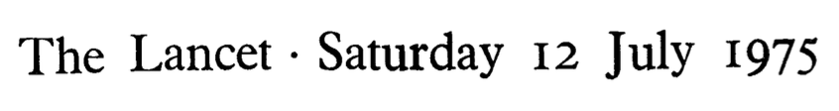
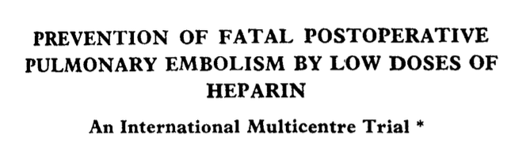

Slide 3
Hypothesis
Multiple trials had shown that periop low dose (LD) SQH reduced DVT rates (by imaging) -> clinical relevance remained unknown
Does LD SQH…
Prevent fatal postop PEs?
Increase risk of operative and postop bleeding?

Slide 4
Methods
Subjects: 4121 patients undergoing elective major surgery
  Inclusion criteria: >40 yrs, no thyroid/L breast/LE surgery
  Major surgery criteria: GA, >30 min, hospitalization ≥7 days, no other AC
Prospective RCT at 28 centers worldwide
  2076 controls (no ppx), 2045 given heparin
    5000U SQ Ca heparin, 2 hrs preop and q8h for 7 d (or until ambulating)
      ?with SCDs?
    Matched for age, sex, weight, blood type, risk factors*, surgery type*
  Followed until dc or in-hospital death
End points
  PE rate (by autopsy)
  DVT rate (clinical, phlebography, ¹²⁵I-fibrinogen test, autopsy)
    ¹²⁵I-fibrinogen test: ≥20% count difference from other leg for ≥ 24 hrs
  Periop blood loss: EBL, transfusion requirement, preop/POD7 Hgb, hematomas
Notes:
¹²⁵I-fibrinogen test:

Slide 5
Methods

Slide 6
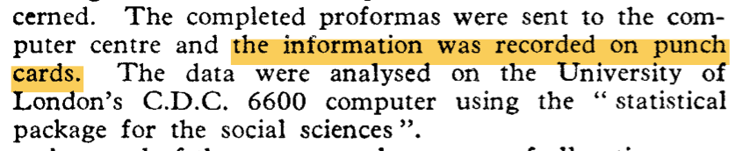
Methods
Notes:
¹²⁵I-fibrinogen test:

Slide 7
Results: Fatal Perioperative PEs
4.4% all-cause mortality rate
  Control 4.8% (n=100) , SQH 3.9% (n=53)
Fatal massive PES: 16 in control group (0.7%), 2 in SQH group (0.1%)
  However, PEs diagnosed via autopsy: 72% of controls and 66% SQH group who died had autopsies
  Mean onset of PE: 14d (control) vs 2d (SQH)
    Preexisting DVTs/PEs?

Slide 8
Results: DVTs
Rate of DVTs (dx by ¹²⁵I-fibrinogen)
  24.6% in controls, 7.7% in SQH group (p<0.005)
Similar differences in DVT rate when diagnosed clinically or on autopsy
(Wind, water, wound, walking…)

Slide 9
Results: Intraop and Postop Bleeding
3.4% (n=70/2045) in SQH group discontinued ppx, 75% (n=53) due to bleeding complications
Excessive intraop bleeding: 6% in controls, 9% in SQH group
Wound hematoma rate: 5.5% in controls, 7.7% in SQH group
No difference in transfusion requirement or postop Hgb change

Slide 10
Strengths/Weaknesses of This Study
Strengths
  Well-designed, randomized trial that is appropriately powered and performed at multiple centers in different countries
Weaknesses
  PEs are rare events
  Limited sensitivity in detecting DVTs and PEs
  Only ~2/3s of mortalities in each group had autopsy data

Slide 11
More modern metanalysis data
Mismetti et al. (Br. J Surg 2001)
  LMWH vs placebo: 8 RCTs, ~5000 general/abd surgery patients
    LMWH prophylaxis reduced risk of
      symptomatic VTE by 70% (14% -> 4%),
      PE by 75% (0.5% ->0.125%)
    2x risk of major bleeding (2.8%) and wound hematomas (10.3%)
  LMWH vs UFH: 51 RCTs, 48,624 patients
    No difference in DVT (5%) or PE risk (0.4%)

Slide 12

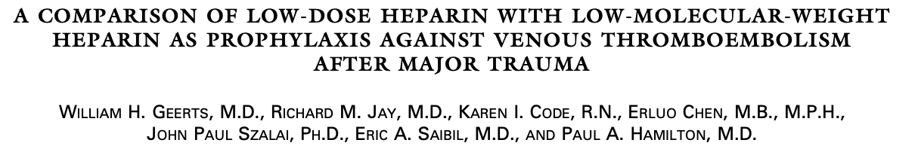
Sept 5th, 1996

Slide 13
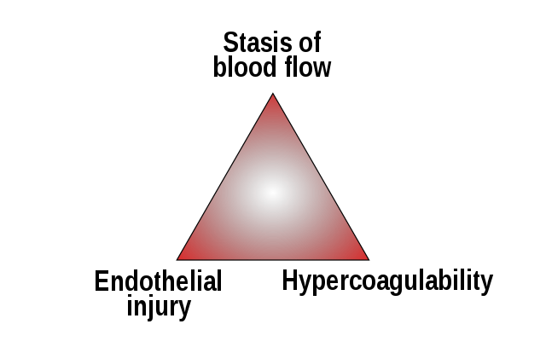
VTE and PE in Trauma Patients
???
PEs found in 2-22% of trauma patients
  Fatal PEs is the 3rd most common cause of death in these patients
Many unable to tolerate SCDs 2/2 leg fractures

Slide 14
Methods
Double blind RCT from 1992-1993 at Sunnybrook Health Science Centre (largest Canadian level 1 trauma hospital), n=265
Exclusion criteria: ISS ≤9, +intracranial bleed, expected survival or hospitalization time <1 week, uncontrolled bleeding >36hrs, DIC, renal failure (Cr>3.4), pregnant, unable to undergo venography
Treatment: 5000U SQH BID vs 30mg Lovenox BID, starting at 36 hrs after injury up to 2 weeks, no SCDs
  Single dose held if going to OR, restarted postop
Evaluation: LE venography between day 10-14, or just before dc
  V/Q scan/pulmonary angiography if PE suspected
Primary endpoint: DVT and PE rate by contrast venography
Additional endpoints: bleeding (↓ Hgb ≥2, ≥2U PRBCs, RP/intracranial bleeding, OR to control bleeding)

Slide 15
Majority are blunt injuries

Slide 16
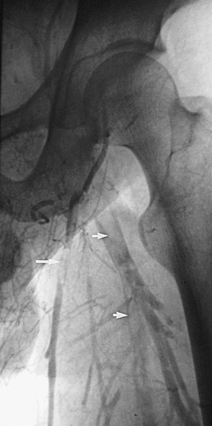
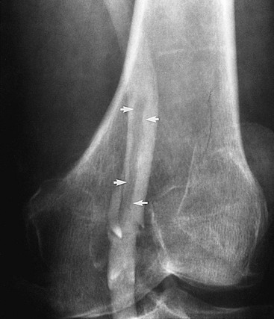
Ascending venography
Contrast injected into superficial vein on dorsal foot as patient in steep reverse T
Table tilted flat and fluoro used to identify veins

Slide 17
Results
DVT rates: 44.1% in SQH group, 31% in LVX group (!)
  30% RRR with LVX (95% CI 4-50%, p= 0.014)
Increased rate of proximal LE DVT higher in SQH group (15% vs 6%)
Low bleeding risk with either treatment:
  1.7% of all patients had major bleeding event (ns)
No fatal PEs, only 1x PE in LVX group

Slide 18
Take home points
Patients undergoing non-ortho surgeries
  Either LD SQH or LVX effective at preventing DVTs and PEs
In trauma patients:
  30mg BID lovenox is more effective vs SQH at preventing DVTs, but DVT risk still high
  Can start within 36 hours of injury
  Risk of major bleeding with ppx AC low
  No need to hold AC for additional surgical procedures

Slide 19
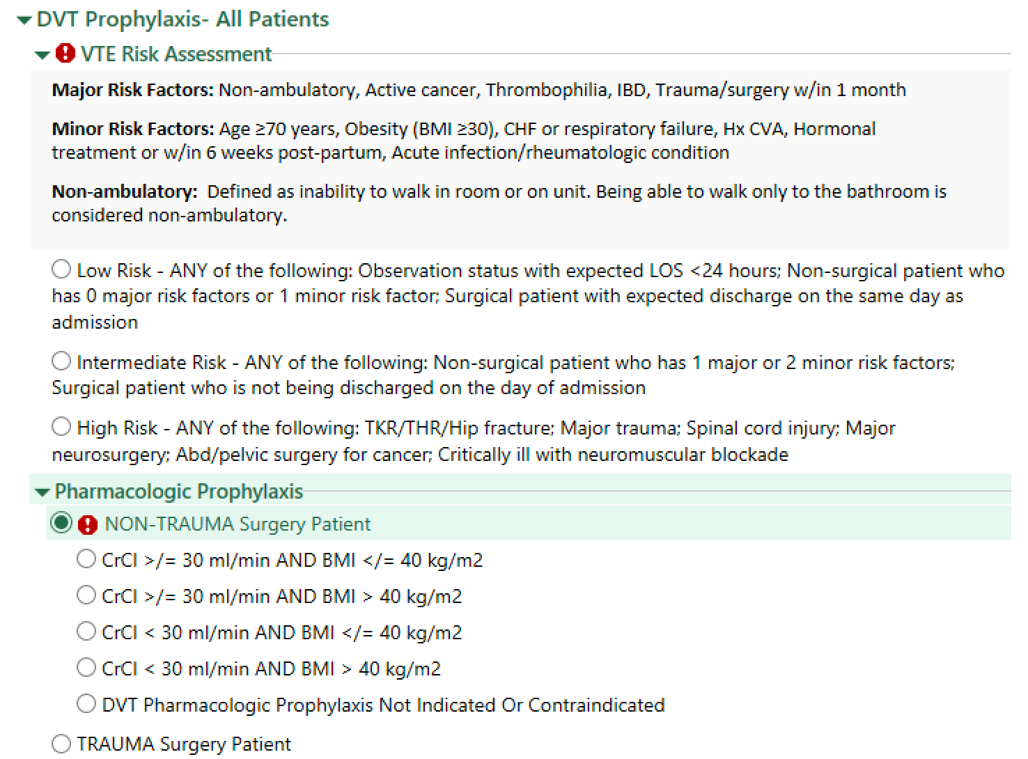

Slide 20
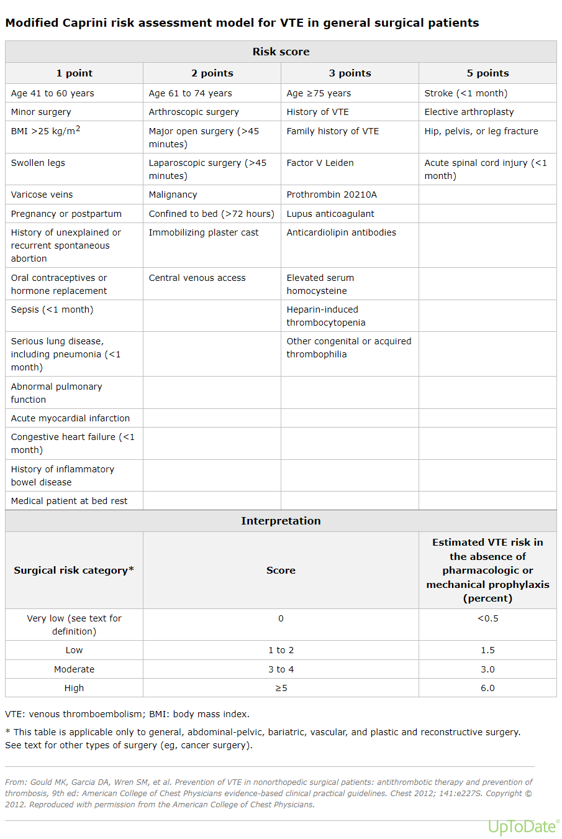
Modified Caprini Score
MC model to predict perioperative VTE risk
Validated in patients undergoing general surgery (breast, endocrine, abdominal/pelvic surgery) but generally accepted for use in bariatric and vascular surgery
Most of our patient population falls into the moderate to high risk category
UpToDate

Slide 22
References
Geerts WH, Jay RM, Code KI, et al. A comparison of low-dose heparin with low-molecular-weight heparin as prophylaxis against venous thromboembolism after major trauma. N Engl J Med. 1996;335(10):701-707. doi:10.1056/NEJM199609053351003
Kakkar et al. Prevention of fatal postoperative pulmonary embolism by low doses of heparin. An international multicentre trial. Lancet. 1975;2(7924):45-51.
Mismetti P, Laporte S, Darmon JY, Buchmüller A, Decousus H. Meta-analysis of low molecular weight heparin in the prevention of venous thromboembolism in general surgery. Br J Surg. 2001;88(7):913-930. doi:10.1046/j.0007-1323.2001.01800.x
Nair P, Trivedi R, Hu P, Zhang Y, Merchant AM. Low-molecular weight vs. unfractionated heparin for prevention of venous thromboembolism in general surgery: a meta-analysis. Updates Surg. 2021 Feb;73(1):75-83. doi: 10.1007/s13304-020-00872-w. Epub 2020 Sep 3. PMID: 32880870.
UpToDate, “Prevention of venous thromboembolic disease in adult nonorthopedic surgical patients”

